Slide 1
International TechNet Wiki Summit
2015
Richard Mueller
Active Directory: Leading Spaces in Names
http://social.technet.microsoft.com/wiki/contents/articles/29168.active-directory-leading-spaces-in-names.aspx

Slide 2
Agenda
    How I Came Up With the Idea for the Wiki
    How I Researched the Topic
    Solution to this Problem
    Organization of the Article – Features I used
    How to Make an Article More Useful – Help People Find It

Slide 3
How I Came Up With the Idea for the Wiki
    Previous Work on Characters Escaped with \ in AD:
    , \ # + < > ; “ =
    Only needed for Distinguished Names
    Feedback – Leading Spaces Also Must be Escaped
    After Testing, Trailing Spaces Also Must be Escaped
    Example: cn=\ Wilson\, James\ ,ou=East,dc=domain,dc=com
    Forum Thread: User Could not be Found in ADUC
    Assigning Manager to User
    Add User to a Group
    Filter in ADUC

Slide 4
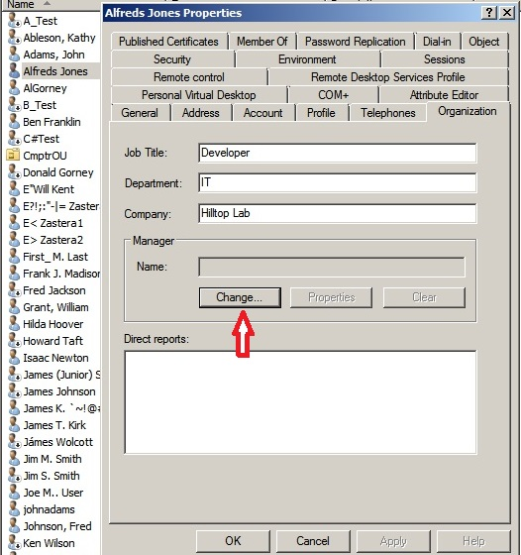
Research: Assign Manager in ADUC

Slide 5
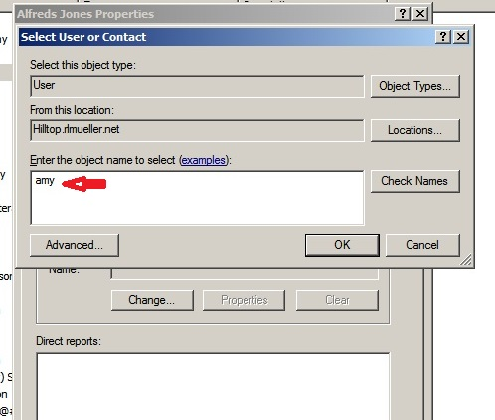
Attempt to Select cn= Amy Tuttle

Slide 6
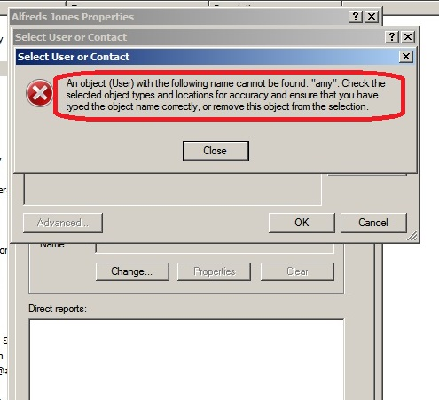
The Result

Slide 7
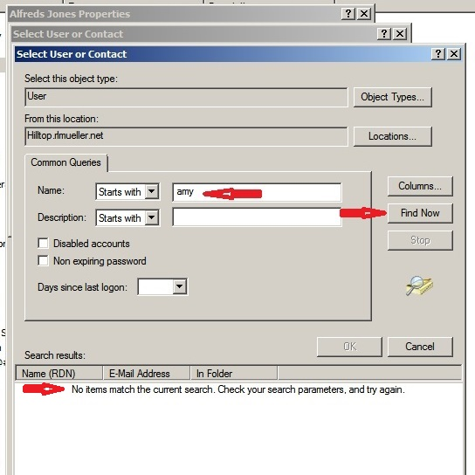
Using “Advanced” Tab

Slide 8
Why Have Names with Leading Space
    Make the Users Difficult to Find
    Obscure the Real Name (leading space easy to miss)
    Make Name Appear First Alphabetically
    By Mistake (bulk creation using script)

Slide 9
Solution or Workaround
    Remove Leading Spaces from all Names of all Objects
    Objects can be Users, Contacts, Groups, Computers, Organizational Units, Domain Components

Slide 10
How to Find Objects with Leading Spaces in the Name
    LDAP Syntax Filter
    “(Name=\20*)”
    PowerShell Syntax Filter
    {Name –Like “\20*”}
    Name is the Relative Distinguished Name (value of cn for users)
    “*” is the Wildcard character
    ASCII hex representation of space character = 20

Slide 11
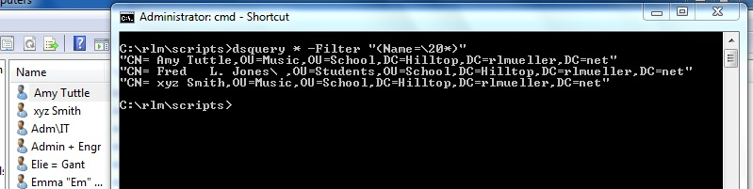
Solution with LDAP Filter (dsquery)

Slide 12
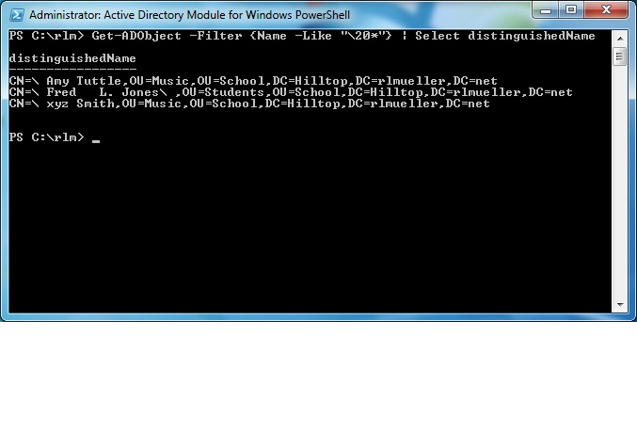
Solution with PowerShell Filter

Slide 13
Fix – Rename the Objects
    To Remove a Leading Space in a Name, You Must Rename
    You Cannot Modify Name directly
    The System Does Not Allow You to Modify the cn Attribute

Slide 14
Features Used in the Wiki Article
    Headings
    Table of Contents [TOC]
    Other Resources Section
    See Also Section
    Cross-Linking

Slide 15
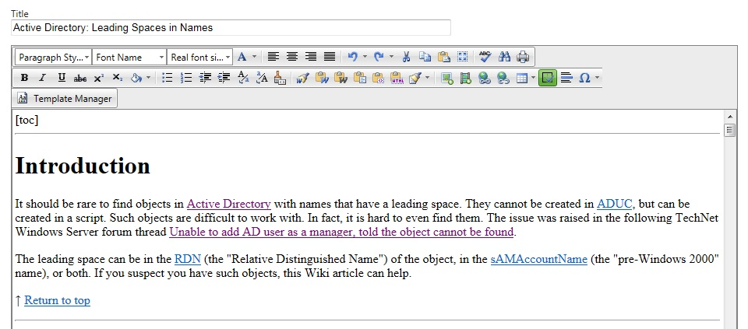
Table of Contents: Edit Mode

Slide 16
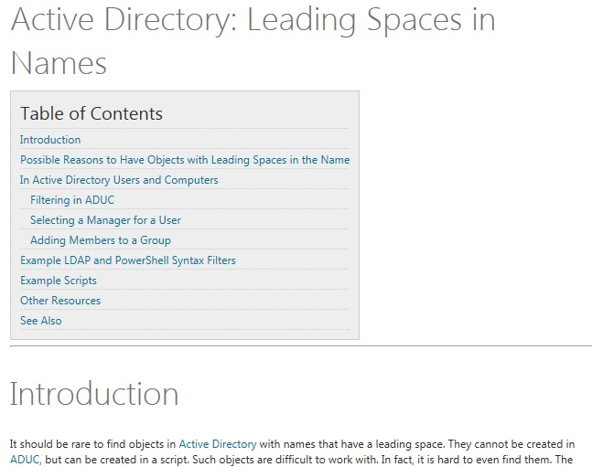
Table of Contents

Slide 17
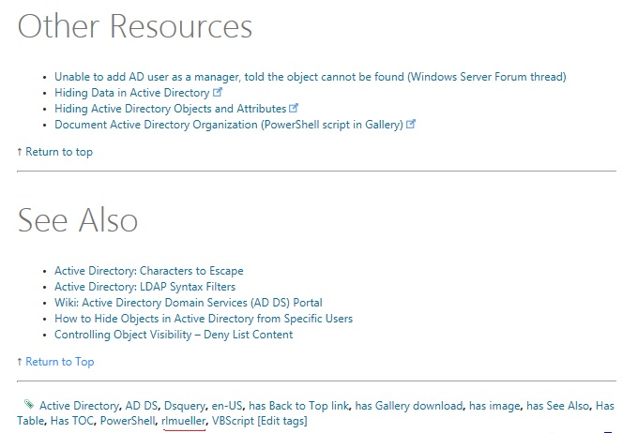
Other Resources and See Also

Slide 18
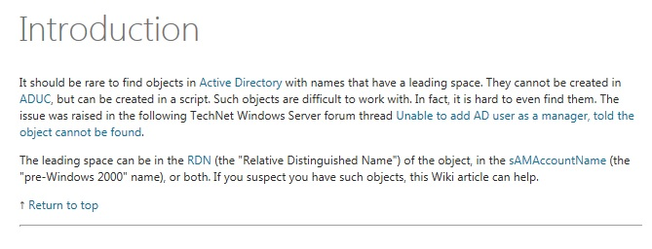
Cross-Linking

Slide 19
Summary
    The Idea was Prompted by a Forum Question
    I Researched the Issue
    Tested in my Lab Domain
    I Used Features to Improve the Wiki
    Headings
    Table of Contents
    Links – Other Resources
    “See Also” Section
    Hyperlinks to Define Terms and Acronyms (Cross-Linking)

